Slide 1




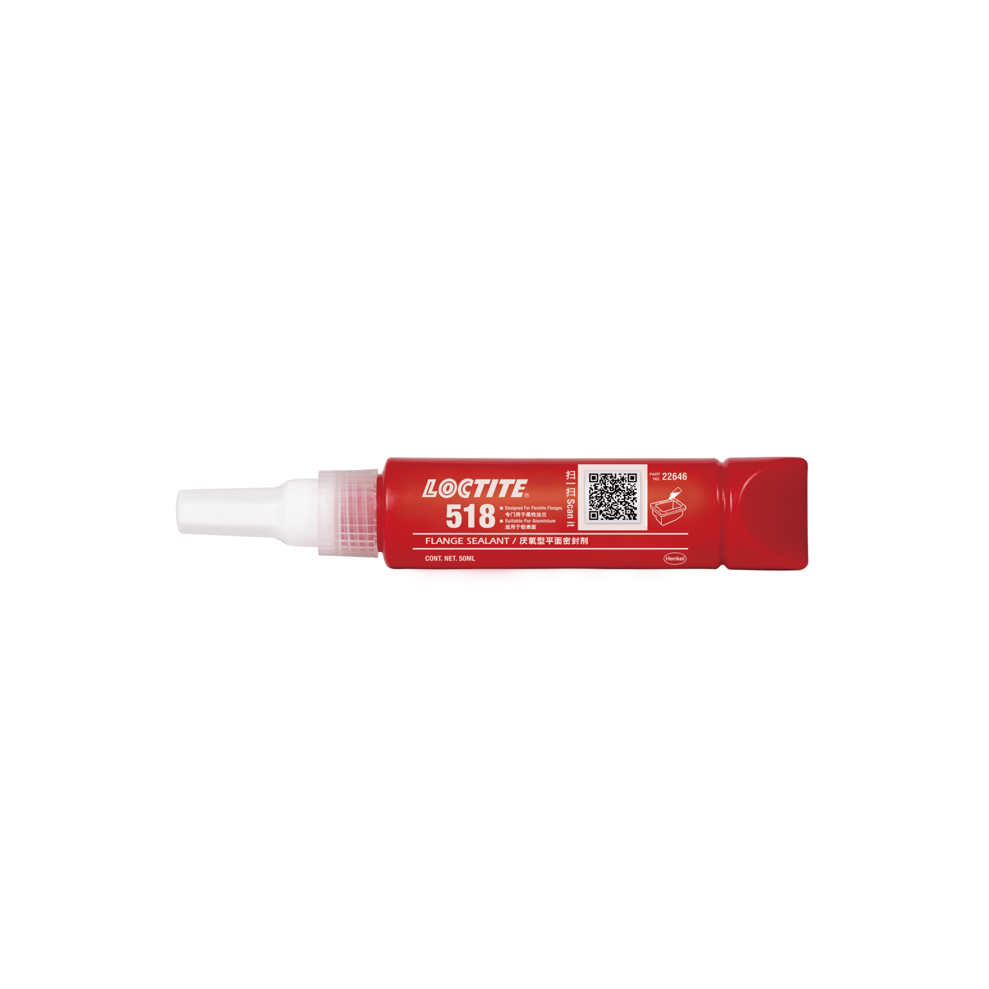
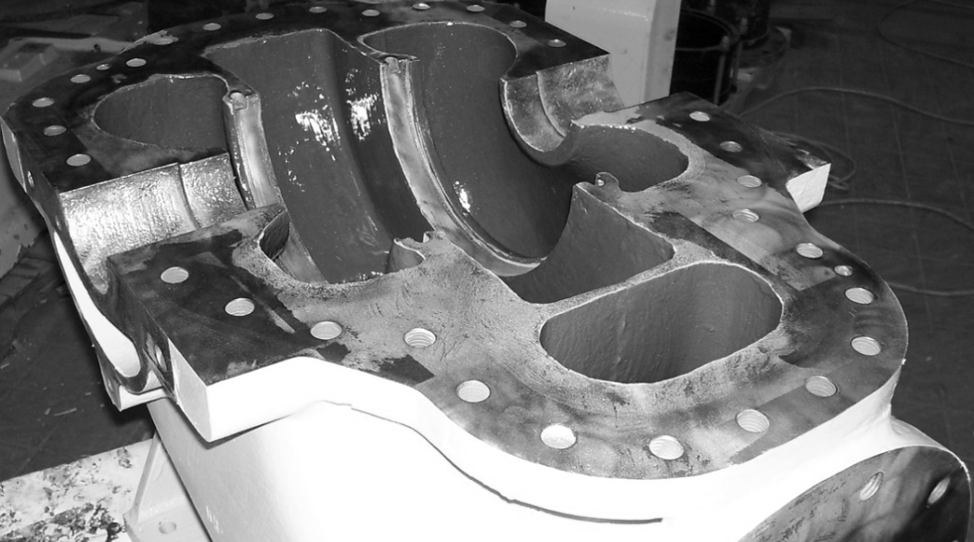



Solution
MANUFACTURING > GASKETING > LOCTITE 518
Henkel’s LOCTITE® 518 was selected as the gasketing solution.
LOCTITE® 518 applied with a roller brush on pump flanges streamlined gasket inventory and ensured reliable, repeatable sealing across multiple designs.
Streamlining Pump Sealing with LOCTITE® 518 Gasketing Solution
Background
Pump manufacturer struggled with cut gaskets, supply chain, and inventory management. Needed a repeatable, leak-proof solution for improved sealing and reduced inventory.
Benefits
UNMATCHED Versatility
LABOR SAVINGS
Reliable
Supply chain
Can be used on 40 different sizes and designs (160 combinations).
No need for hand-cut gaskets and simplifies repairs.
Consistent product availability and quality worldwide.
Henkel Adhesive Technologies
Notes:
Background:
The manufacturer of pumps grappled with challenges stemming from the use of cut gaskets, which led to complications in supply chain logistics and inventory management. An imperative arose for a consistent, foolproof remedy that could enhance the sealing process, curbing leaks effectively while concurrently streamlining inventory management to mitigate excess stock levels.
Solution:
After careful consideration, Henkel's cutting-edge LOCTITE® 518 emerged as the optimal choice for addressing the gasketing challenges.
The application of LOCTITE® 518 through a roller brush technique onto pump flanges marked a significant advancement. This approach not only contributed to the optimization of gasket inventory management but also established a steadfast foundation for dependable, consistent sealing across a spectrum of design variations.
Benefits:
Effortlessly applicable to an impressive array of 40 diverse sizes and designs, resulting in an astonishing 160 possible combinations.
Eliminates the requirement for manually crafting gaskets by hand, streamlining repair processes and saving valuable labor hours.
Guaranteed availability of the product on a global scale, maintaining unwavering quality standards consistently across all regions.
Top tips(Optional)
Confidential information only(Optional)

