Slide 1



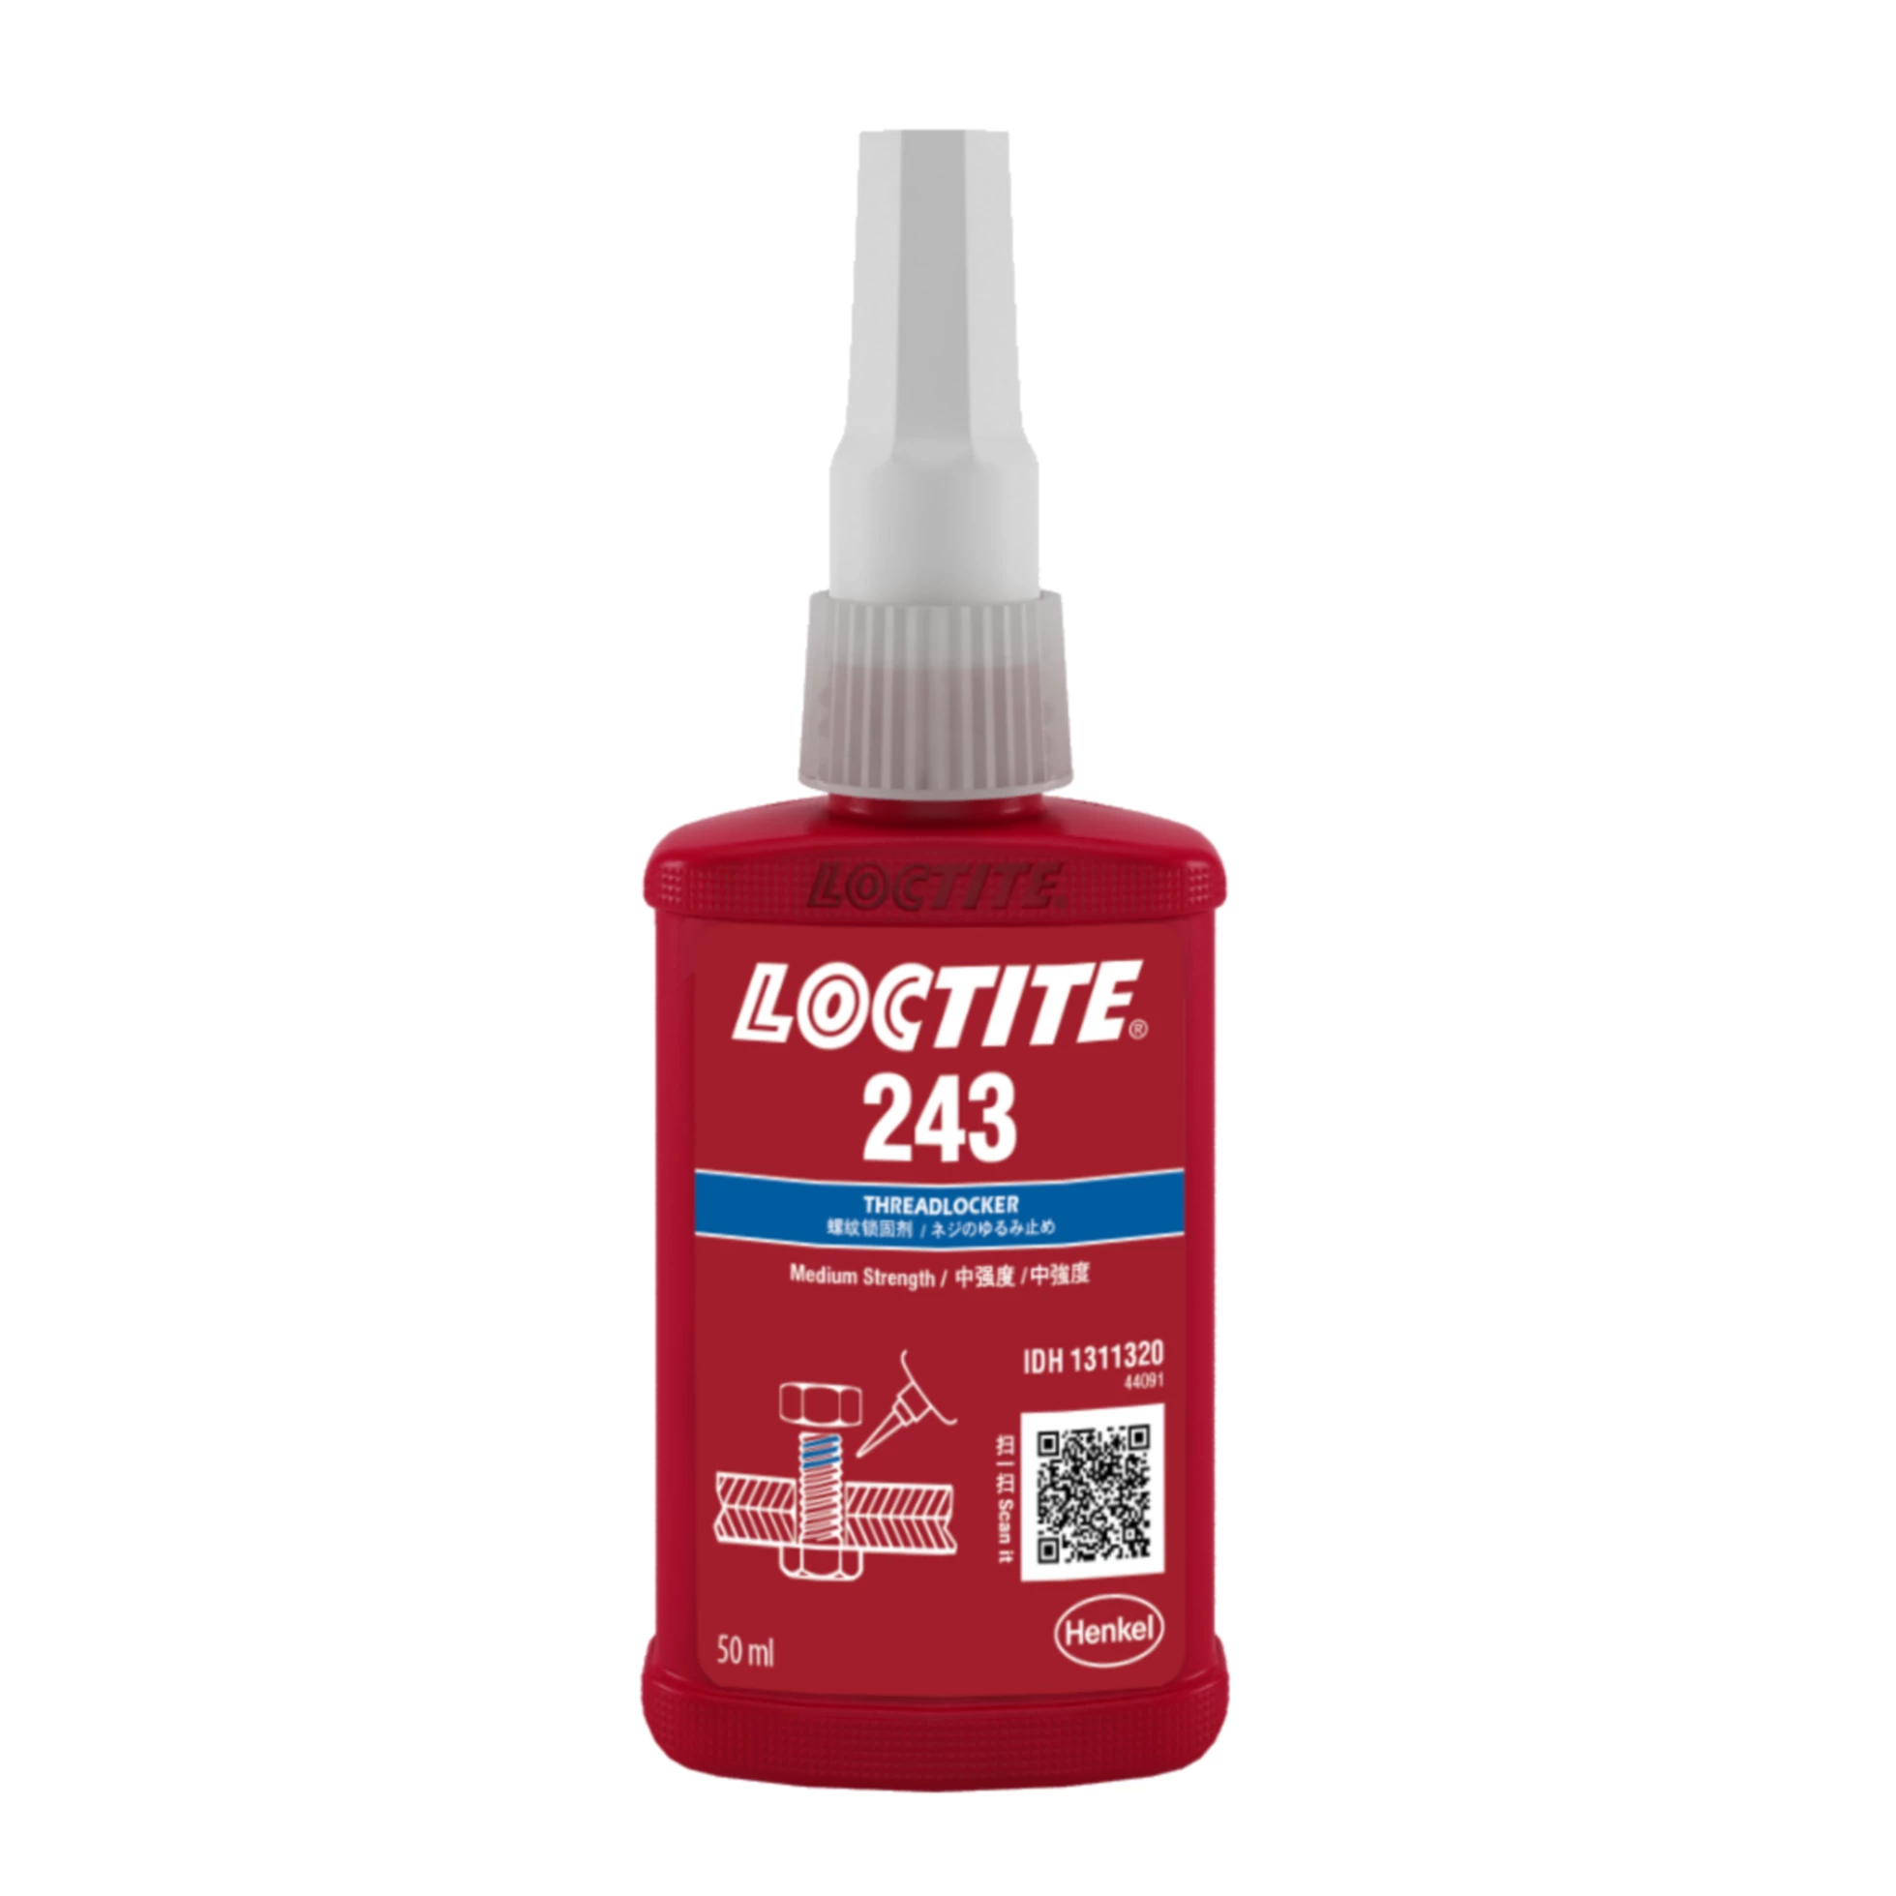
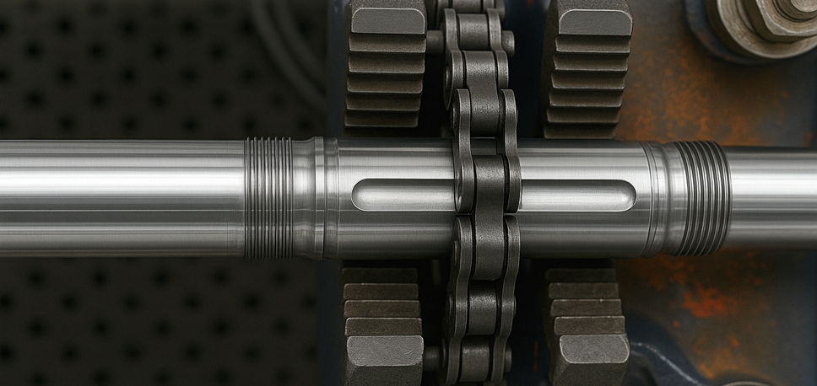


Reliable Threadlocking for Centrifugal Pumps
Solution
LOCTITE 243 provided a reliable threadlocking solution, preventing set screw loosening and ensuring proper impeller alignment.
LOCTITE 243
Background
Main Application: Threadlocking 5/16-18 set screws in centrifugal pump assemblies.
Process: Apply LOCTITE 243 to four set screws in the assembly.
Outcome: The solution reduced warranty claims and improved product performance by preventing vibrational loosening.
A centrifugal pump manufacturer faced premature failure of set screws holding the shaft sleeve, leading to warranty claims and performance issues. The alignment of the impeller was critical to prevent overheating and failure.
Benefits
REDUCED FAILURE RATE
REDUCED COMPONENT COST
IMPROVED PERFORMANCE
The solution reduced warranty claims.
Enabled the use of lower-cost components by eliminating the need for hardened metal and changing set screw point type.
Ensured the impeller remained properly aligned, extending the life of the equipment and improving overall performance.
Beyond the bond

