Slide 1
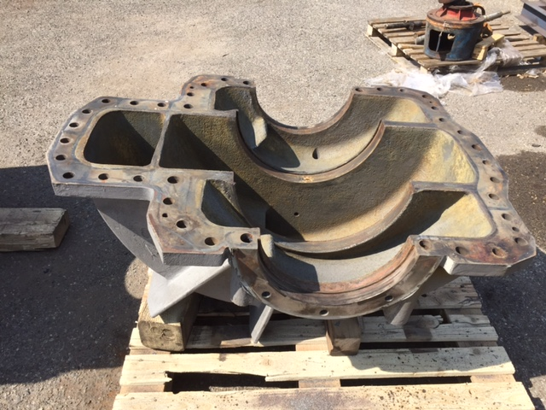
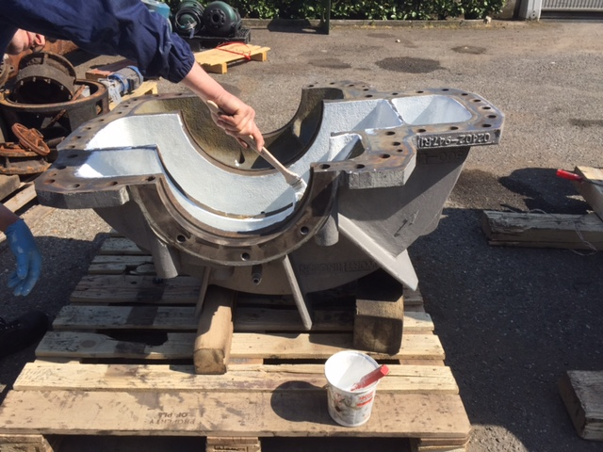
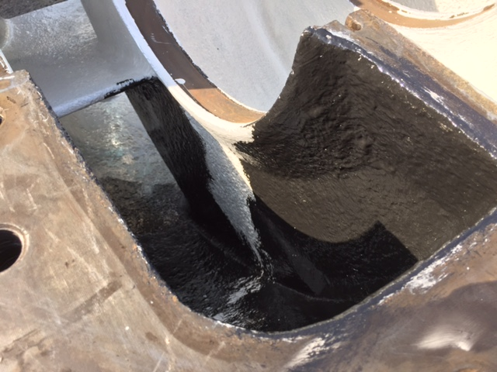
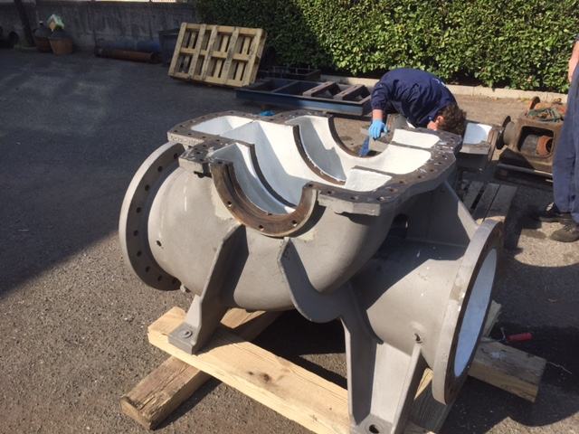
Loctite PC 7228 – PC 7117 Steel Industry Pump Wear Protection
Pump Wear Protection
SITUATION
Pump with worn surface
Substrates: Cast Iron
Joint: Surface
Previous method: Brand New Pump
Prev method problems: Brand new Pump Costs and long lead time
IMAGE
IMAGE
CHALLENGES [product requirements]
… Renew and restore pump in 2 weeks
High wear resistant and High chemical resistant
Fast repair
Efficiency increasing
APPLICATION
Please describe the new Henkel solution
Surface preparation: Loctite SF 7515 and Loctite SF 7063
Product/s: Loctite PC 7228 – Loctite PC 7117
Process description: Brushable ceramic in 2 layers minimum 0,250 mm each
Equipment description: Brush and rollers

Slide 2

Loctite PC 7228 – PC 7117 Steel Industry Pump Wear Protection
/ Pump Wear Protection
CUSTOMER EXPECTATIONS TANGIBLE VALUE FOR CUSTOMER
Easy and fast product application
Reducing plant downtime
Extended service life
Brand new pump cost saving
Shorter downtime
Performance and efficiency increased
Extended time between the planned downtime
PROJECT DETAILS ACH DETAILS
External Use
Other potential markets: Power Generation, Refinery, Chemical Plants, Utilities
KEYWORDS table
Please enter keywords
(double click on table and
select from the drilldown in each column)
Date: 09/03/2021 | Sales Person responsible: Alessandro Nisoli alessandro.nisoli@henkel.com | Technical Service Contact: NAME / eMail

