Slide 1

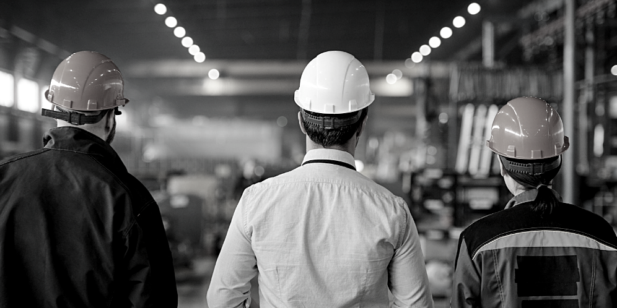

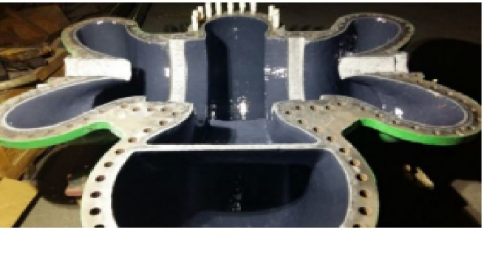
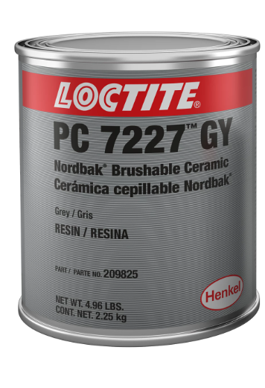
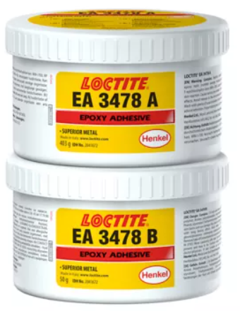

MAINTENANCE > Surface Repair and Protection > LOCTITE EA 3478 & LOCTITE PC 7227
Rebuilding & Coatings for Pumps
LOCTITE EA 3478 & LOCTITE PC 7227
Background
CHALLENGES
A manufacturer was searching for products to repair and protect the casing of a booster pump and avoid the high cost of replacing the entire pump. Products are needed to restore the damaged casing and protect it against further erosion.
  The pump casing is subjected to extreme pitting and erosion caused by abrasion and chemical attack
  Eroded casing reduces pump efficiency and lowers process water delivery pressures
  Complete pump replacement is very expensive and competitive products underperformed expectations
SOLUTIONS
  Henkel's Product (incl. Equipment)*: LOCTITE EA 3478, LOCTITE PC 7227
  Substrates: Cast Iron
  Process Description: The heavily corroded and pitted pump casing was cleaned with grit blasting SA 2.5 to remove corrosion. Surface voids in the pump casing are filled with LOCTITE EA 3478 Superior metal. Care is taken to restore original pump dimensions while leaving room for wear prevention coatings. 500 micron of LOCTITE PC 7227 Brushable Ceramic are applied to internal components for maximum protection against abrasion, chemical attack and cavitation. The casing is protected from further metal loss.
BENEFITS
Component Cost Saving
Restored damaged casing surfaces to near original pump dimensions. Helped to avoid the high cost of pump replacement
Downtime reduced
Product reduced unscheduled downtime / extended MTBF
Device Improved
Solution prevented further damage to the casing and extends the pump service life
Henkel Adhesive Technologies

